Slide 1
House rental management system
Project Members:
Abrar Hossain (ASH1825005M)
Rahat Uddin Azad (ASH1825022M)
Al Jaber Nishad (ASH1825029M)
Kamruzzaman Shekh (ASH1825035M)

Slide 2

Introduction
Our Application/system will provide the information about available flats for renting.
This system will make ease for everyone to find the expected house or flats.
The system will be able to show the flats within a particular area.

Slide 3
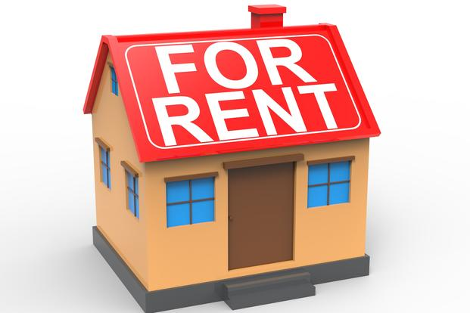
Project Motive
Renting a perfect house in modern life has become a important factor.
And it is difficult to find house for the renter in a specific area.
Same for the landlords and property manager.
This kind of system can help millions of people by easing their finding houses in a better and a proper way.

Slide 4
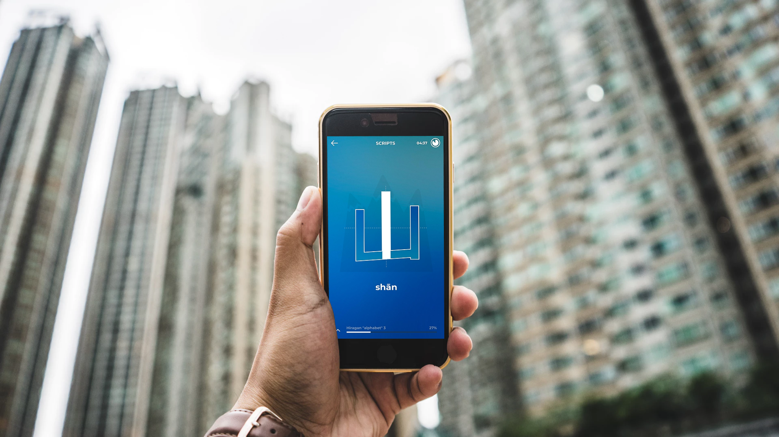
Project Objective
Study of currently available open source applications.
Try to develop an efficient application that’ll be helpful for renters as well as landlords.
In brief, study about requirement analysis and getting a whole project’s requirement collection idea.

Slide 5
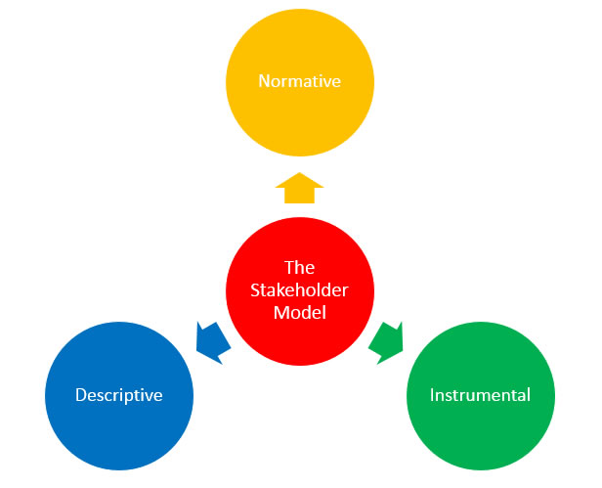
Types Of Stakeholder
There are 3 types of stakeholders in our House Rental Management System. Such as
Landlords: Landlords are the main stakeholder for the system. Here they can create ads for their house and add the information of a tenant who lives in their house.
Tenants: Tenants also our stakeholder for the system but they can only see the house information and the contact number of the landlords. From all the stakeholders, tenants have a limited access like they can only see house ads and can bookmark them.
Police Officers: This type of stakeholder can access landlords and tenants information. They are the higher authority of the system.
Police Officers
Landlords
Police Officers

Slide 6
Functional Requirements
Stakeholders can search house based on some specific criteria.
Stakeholders can search house based on their location.
Stakeholders found any desired ads he wants to see later, he can bookmark that ads and see the ads in favorite section.
Stakeholders wants to get notified when a house is available for rent nearby his location.
Tenants can communicate with landlords.
Landlords are able to create ads and upload it in our system.
Landlords can boost his ads.
Landlords can add and store tenant’s information.
Police officers has ability to access tenants and landlord’s information like national id card information, contact number.

Slide 7
Non Functional Requirements
Security: The subsystem should provide a high level of security and integrity of the data held by the system. and only users with valid password and username can login to view user’s page.
Performance and Response time: The system should have high performance rate when executing user’s input and should be able to provide feedback or response within a short time ,like faster searching houses and load ads quickly.
Availability: This system should always be available for access at 24 hours.

Slide 8
Requirements Elicitation
Requirement Elicitation is the process of interacting with customers and end-users to find out about the domain requirements, what services the system should provide, and the other constraints. We mainly use these techniques for gathering Requirement: • Interview • Questionnaire • Existing System Analysis

Slide 9
Interview
Interview is a good technique to investigate issues in-depth, to discover how people think and feel about certain topics. We hold interviews that can be performed with a small group of stakeholders. We mainly perform our interview based on some specific criteria.
Short description about project (Goals and objectives)
Registration process
Ways of search a house
Security
Advertisement of a house
Boosting
Ads cost

Slide 10
Questionnaire
Questionnaire is a useful technique to investigate trends, shifts in user attitudes and opinion, user satisfaction with priorities and preferences. We created two types of questions set for proper survey. One for tenants, and one for landlords.
Questionnaire for landlords
Questionnaire for tenants

Slide 11
Questionnaire For Landlords
What type of problem do you face to get your home rented?
What kind of information do you collect from tenants?
How secure do you think collecting money from tenants by online payment method?
How secure do you feel it is to advertise your home in online?
In your opinion how much should each ad cost per day?
What is your opinion about our online review system?
What other features or facility do you think should be added to this system?

Slide 12
Questionnaire For Tenants
Tell us your opinion about this system.
When you want to rent a house, then what type of information is important to know about that house?
What is your opinion about our online review system?
What type of security do you need from this system as a user?
What other features or facility do you think should be added to this system?

Slide 13
Existing system analysis
Existing system Analysis can help reveal how systems currently work or what they are supposed to do. Analysis includes any written information about current systems, business processes, requirements specifications, competitor research.
After existing system analysis, we found many several problems on existing system.
With the current system recording the details of various activities of user is completely manual and entails a lot of paper work.
The existing system only provides text-based interface which is not as user friendly as Graphical user interface
The transactions are not secure as papers may get lost or damaged.

Slide 14
Positive Review
Notification alert message: If there is a available house for rent in selected area the user will get notification.
Free boosting: If a home is not rented within two month after advertisement then our system will provide free boosting for one month.
Auto serialization: Non boosted Ads will appear in random serialization.

Slide 15
Difficulties and negativities
Difficulties:
Someone wants our system in social media (IMO).
Most of the people think that the existing system (manual) is most suitable for them.
Some Owner are not interested to discuss with us. Because they feel not much familiar with this system.
Some people not interested to pay for positing ads in the system. As they think that this is waste of money.
Negativities:
They are not familiar with review system.
Owners are not interested to collect money by online payment method.

Slide 16
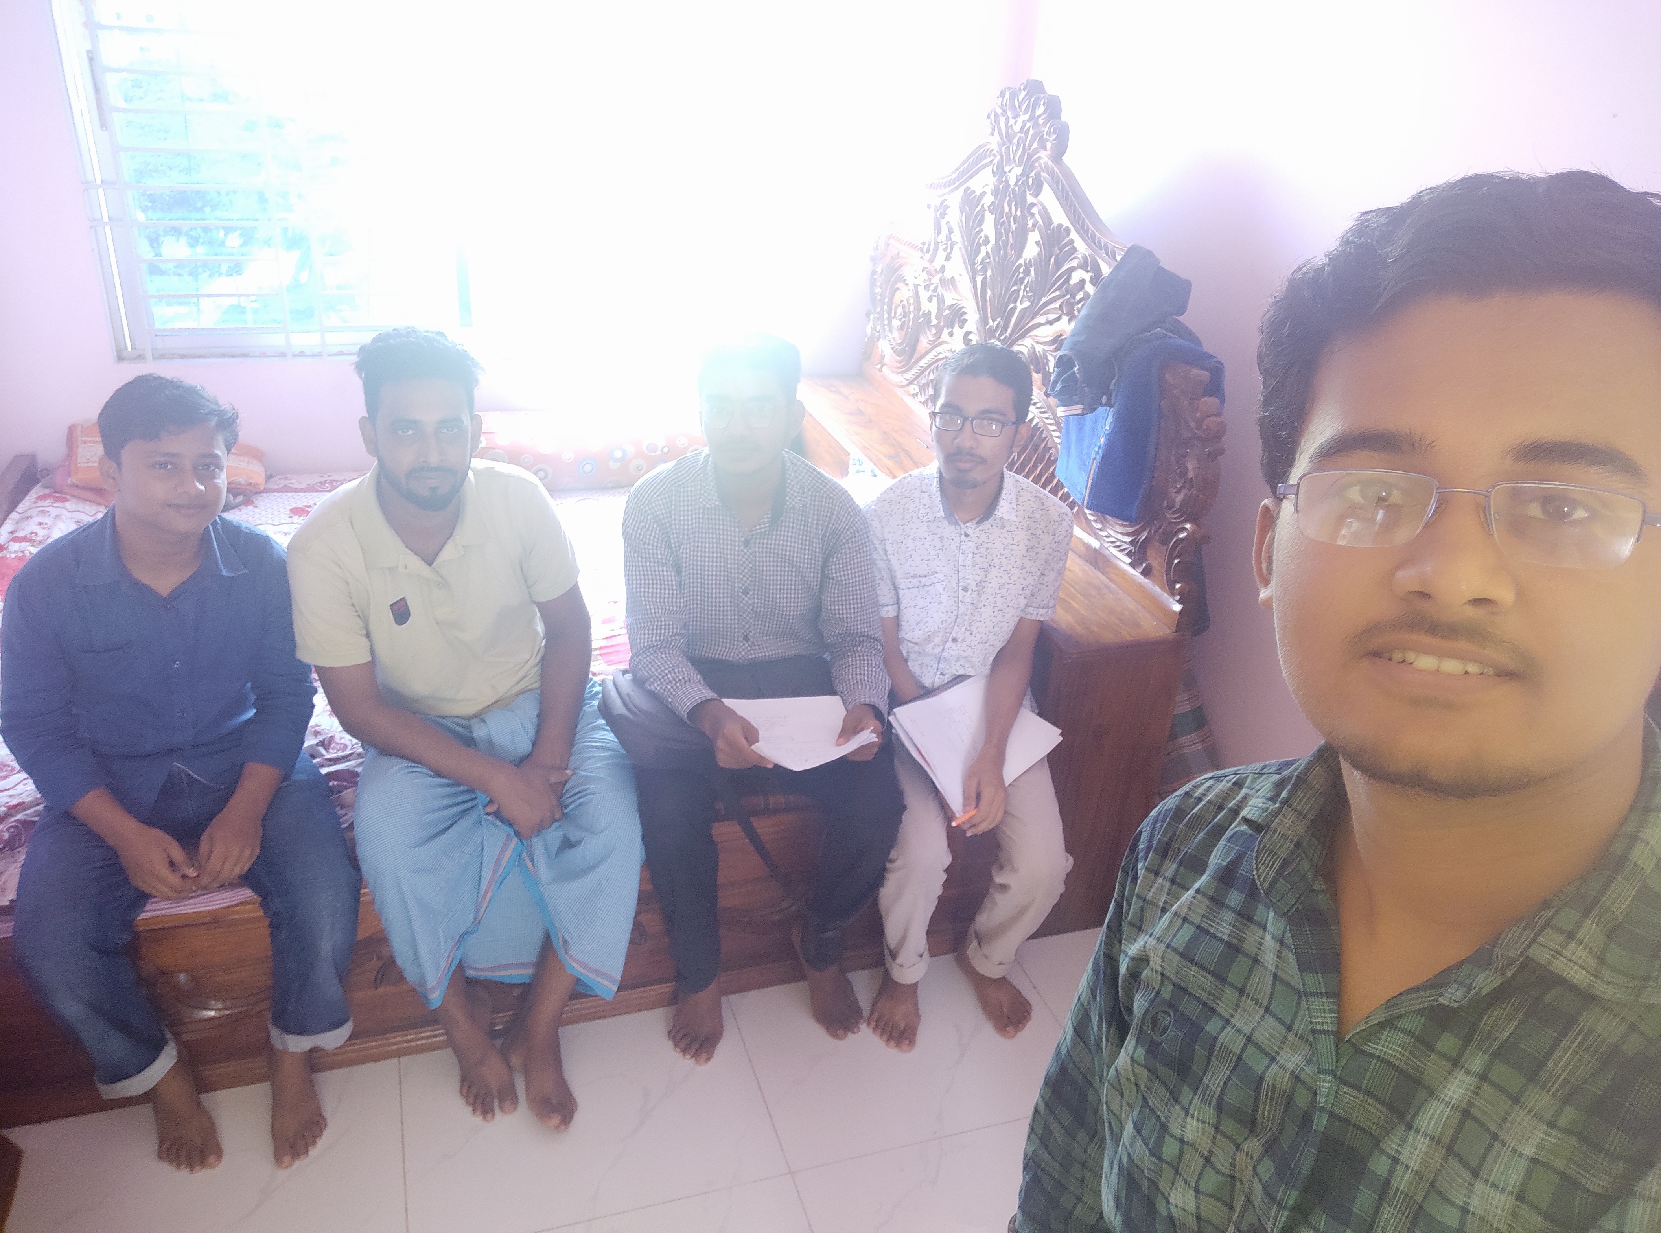
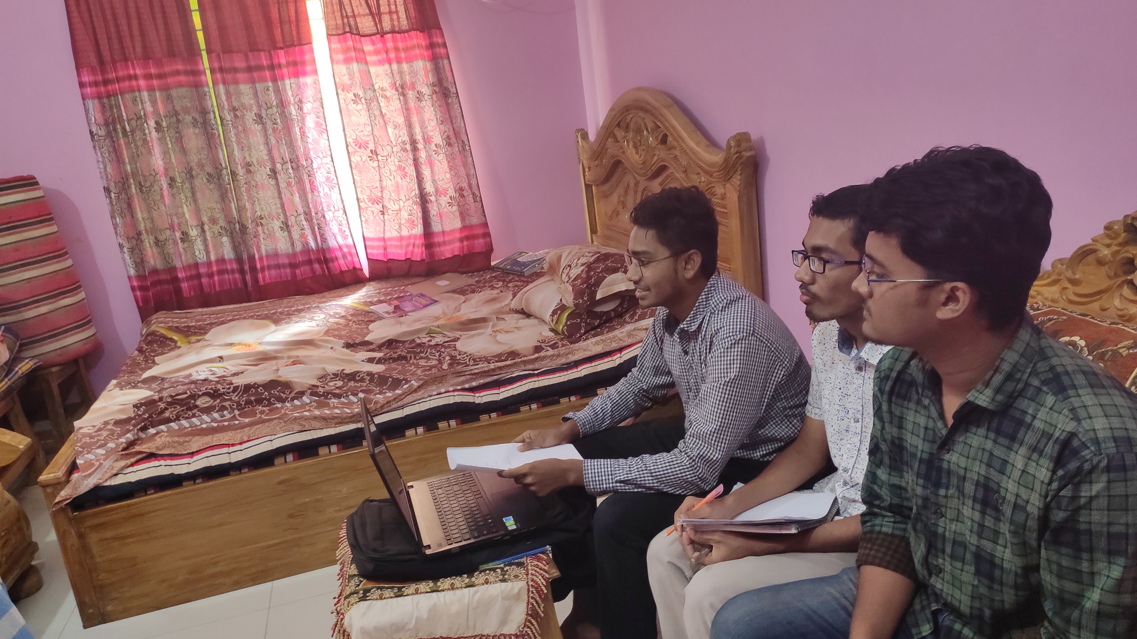
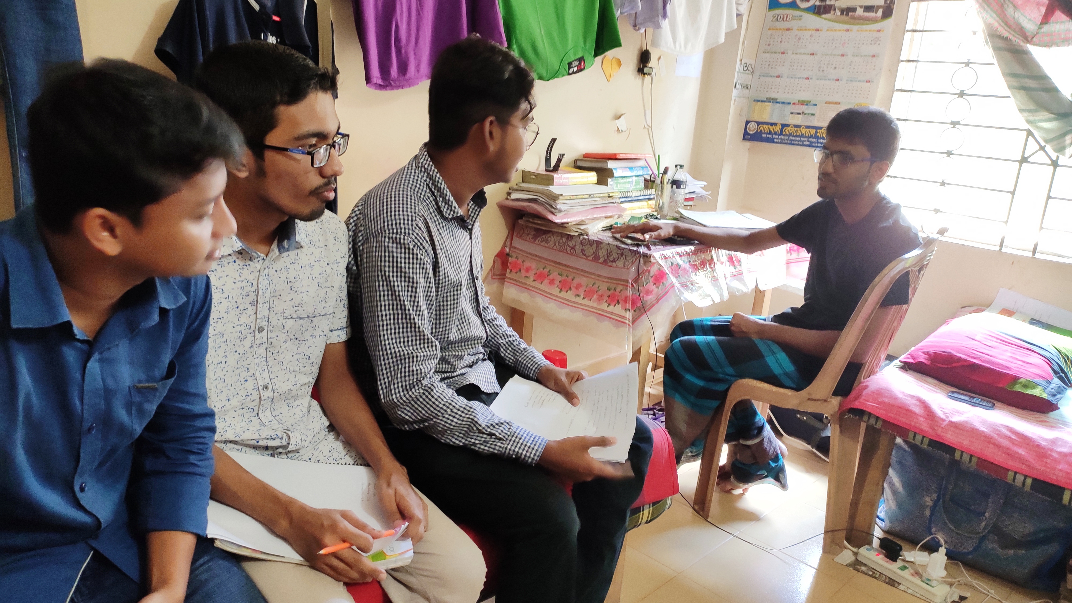
Pictures during elicitation

Slide 17
Requirements Analysis
Requirements Analysis is the process of defining the expectations of the users for an application that is to be built or modified. Requirements analysis involves all the tasks that are conducted to identify the needs of different stakeholders. Therefore requirements analysis means to analyze, document, validate and manage software or system requirements. High-quality requirements are documented, actionable, measurable, testable, traceable, helps to identify business opportunities, and are defined to a facilitate system design.

Slide 18
Use Case Diagram
A UML use case diagram is the primary form of system/software requirements for a new software program underdeveloped. Use cases specify the expected behavior (what), and not the exact method of making it happen (how).

Slide 19
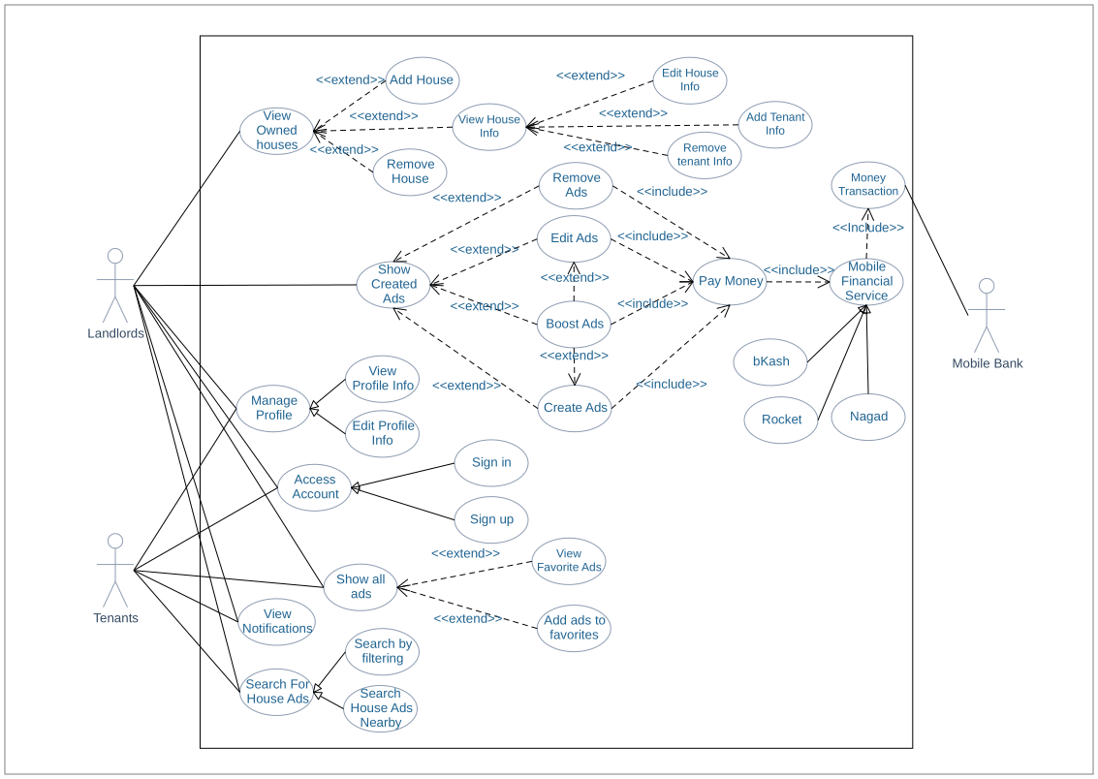
Use Case Diagram

Slide 20
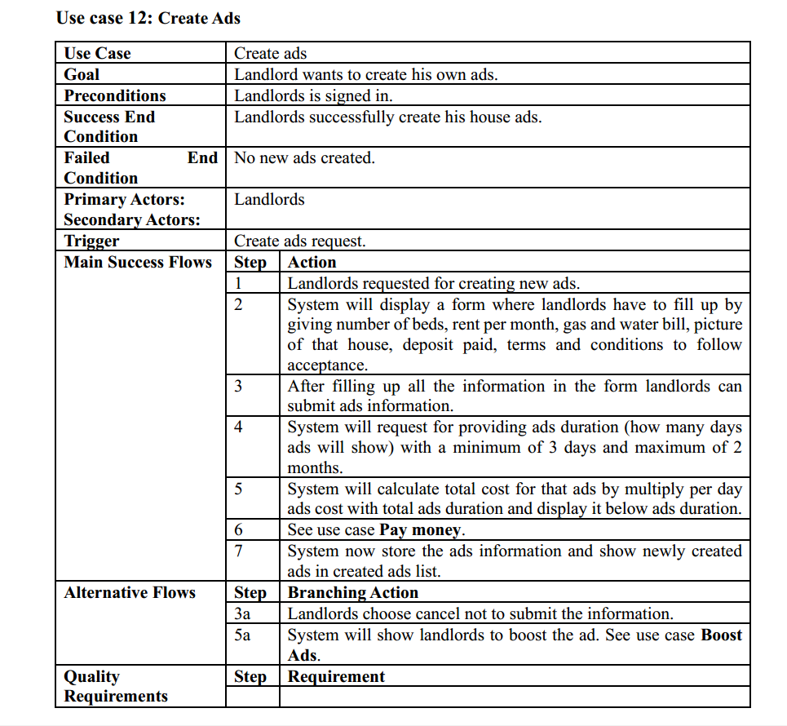
Use Case Description

Slide 21
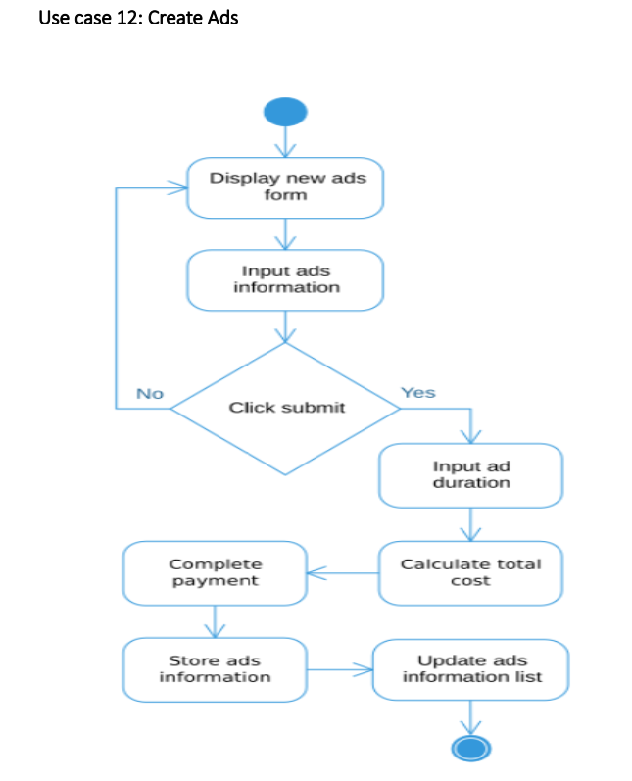
Activity Diagram

Slide 22
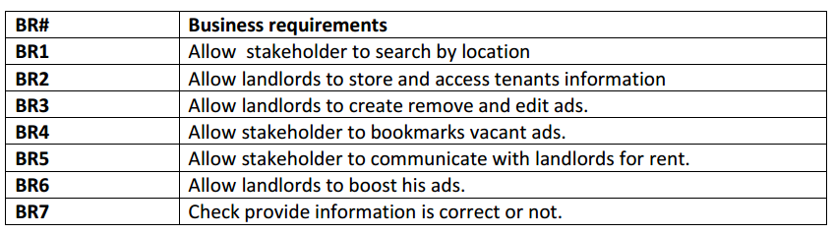
Requirement Traceability Matrix
Business Requirement

Slide 23
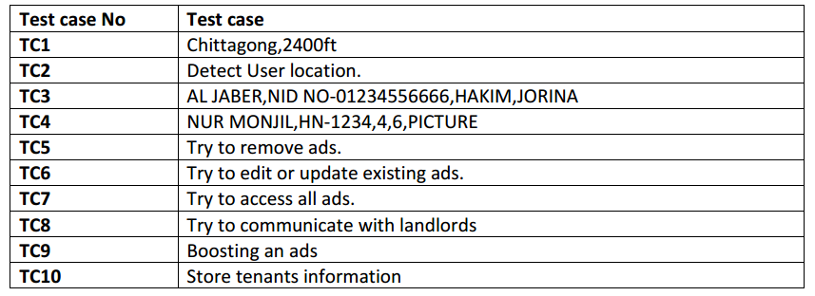
Requirement Traceability Matrix (Cont…)
Test Cases

Slide 24
Requirement Traceability Matrix (Cont…)

Slide 25
Thank You All

